Slide 1
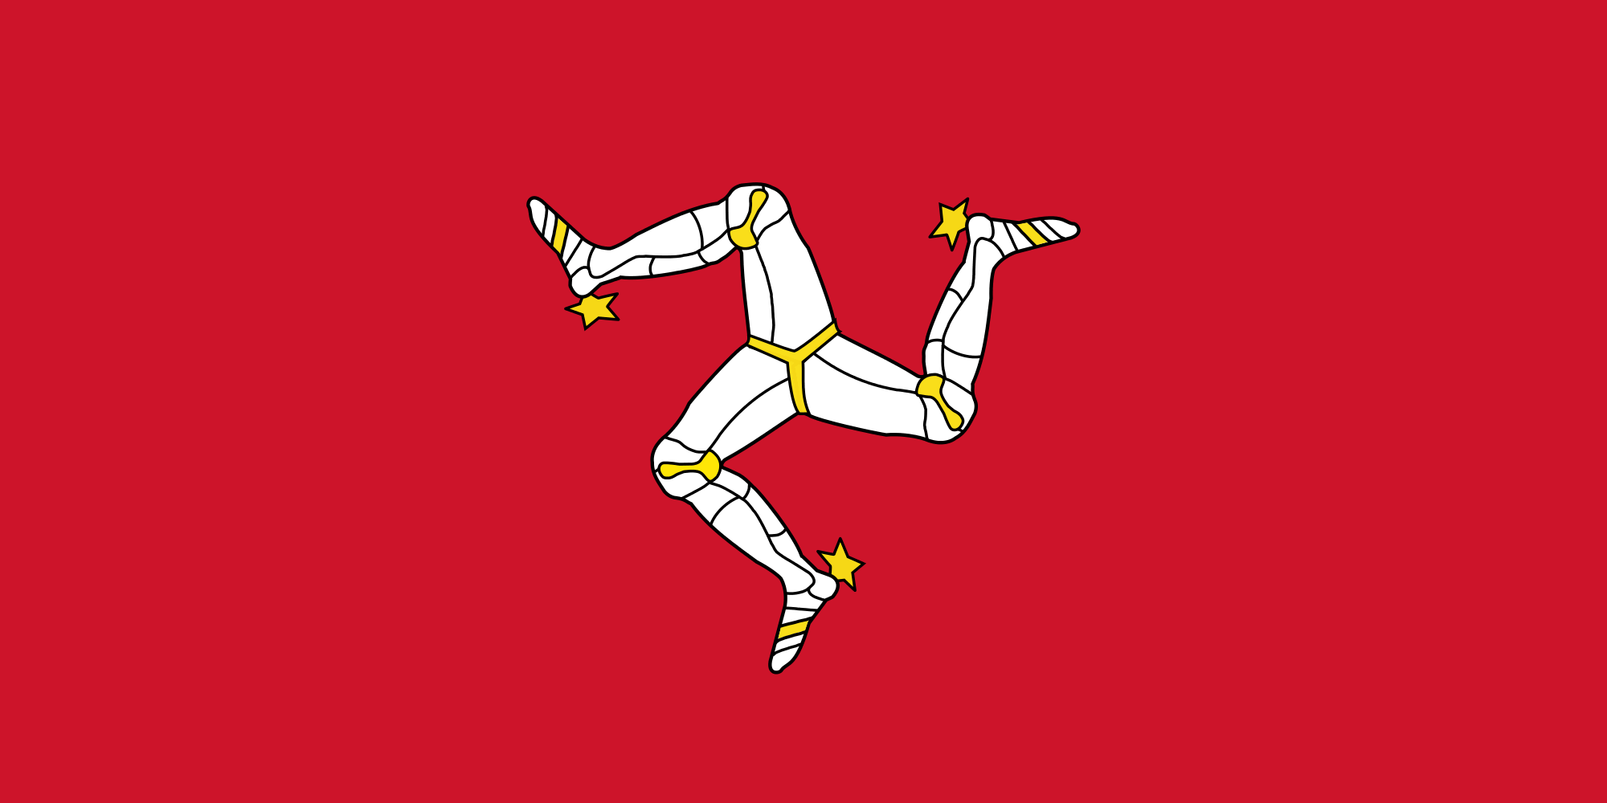
An Introduction to Manx (Gaelic)
Fosley-raa dys y Ghaelg
Notes:
Three legs of Mann / Tree Cassyn Vannin – triskelion dates from 13th century, possibly from Sicily. Moto Quocunque jeceris stabit “Whitersoever you throw it, it will stand”

Slide 2
What is Manx?
Native name: Gaelg / Gailck [gilk/gilg]; / y Gaelg [əˈɣɪlk]
Language family: Indo-European, Celtic, Insular, Goidelic
Descended from Old Irish
Similar to Scottish Gaelic and Irish (Gaelic)
Influenced by Old Norse and English

Slide 3
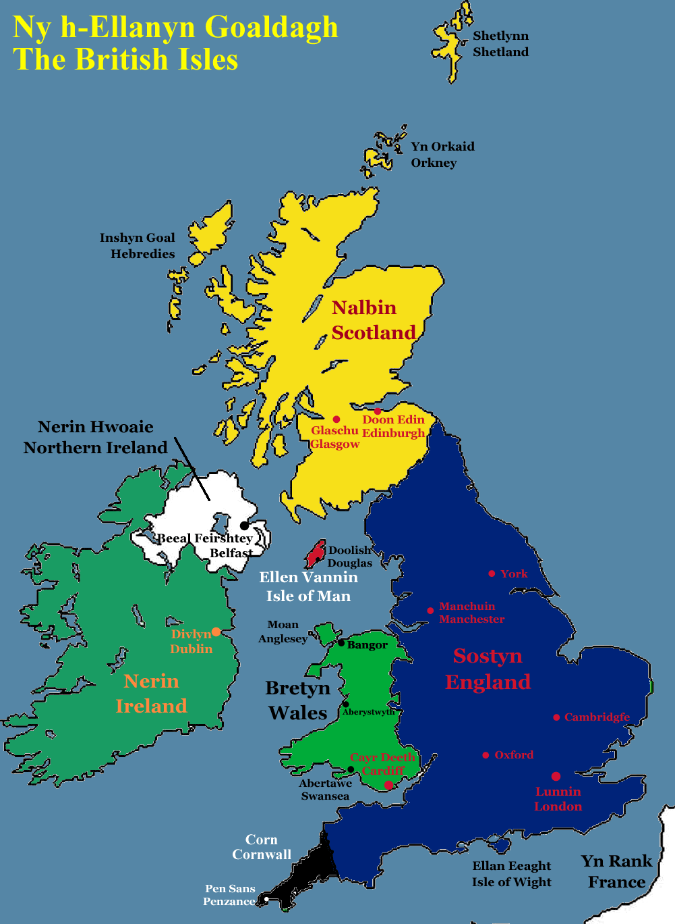
Where is it spoken?
The Isle of Man / Ellan Vannin
- a self-governing Crown dependency in the Irish Sea between Great Britain and Ireland.

Slide 4
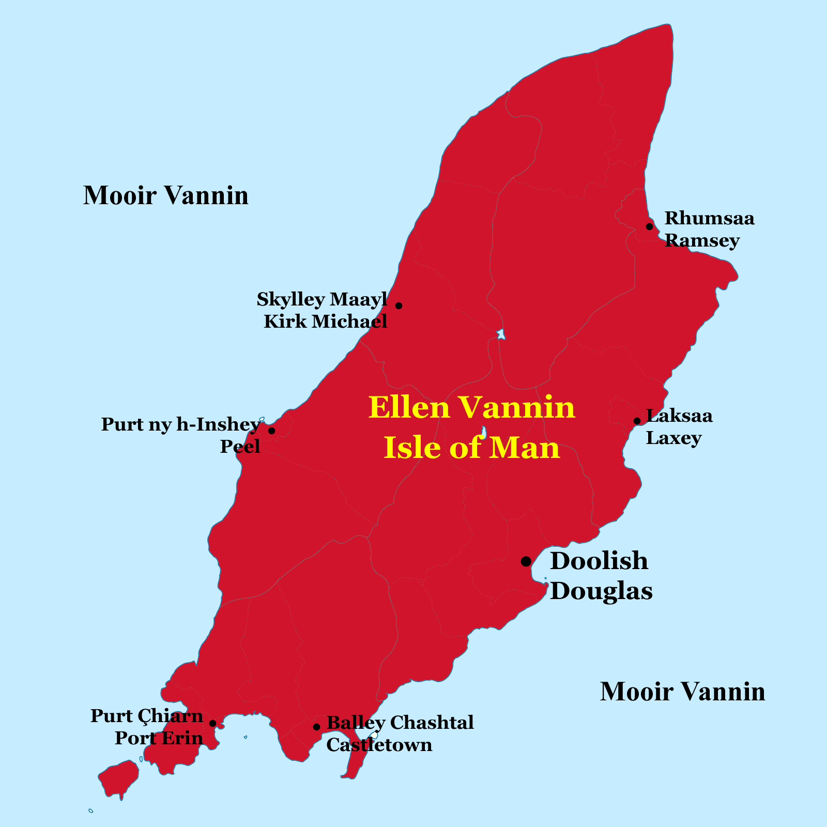

Slide 5
A brief history of Manx
5th Century AD Old Irish brought to Isle of Man
Manx started to emerge as distinct language by the 13th century
Language declined from the early 19th century
Revival efforts from the late 19th century
Disappeared as a community language in the early 20th century
Manx taught in schools from 1980s. Bunscoill Ghaelgagh opened in 2001
1,823 speakers of Manx (2011 census)

Slide 6
Comparison with other Gaelic languages
Manx
Hie mee dys yn thie lhionney / thie oast riyr
Ren mee goll dys yn thie lhionney riyr
Scottish Gaelic
Chaidh mi dhan taigh-seinnse / taigh-òsta a-rèir.
Irish
Chuaigh mé go dtí an teach tábhairne aréir.
Translation: I went to the pub last night
Notes:
lhionney = ale; oast = frequented; seinnse = change (money); òsta = inn; alehouse; tábhairne = tavern, borrowed from Anglo-Norman taverne, from Latin taberna

Slide 7
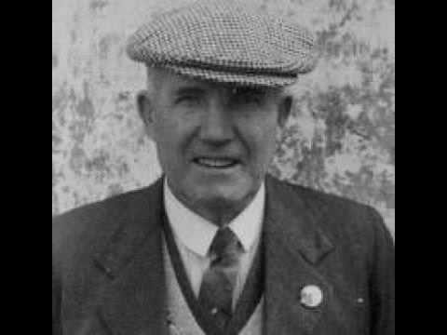
Last Native Speakers
Edward “Ned” Maddrell (1877-1974) was officially the last native speaker of Manx.
Other native Manx speakers survived into the 1980s, but were too ashamed to admit that they spoke Manx.

Slide 8
Manx proverbs and sayings
Çheer gyn çhengey, çheer gyn ennym.
A country without language is a country without an name/identity.
Gyn çhengey, gyn çheer
No language, no country
Tra haink ny skibbyltee boghtey stiagh hie yn Ghaelg magh.
When the tourists came in, the Manx language went out.
Cha jean oo rieau cosney ping assjee.
You'll never earn a penny from it.
Notes:
skibbylt = agile, light-footed, vivacious, nimble, skip, acrobatic, active (as person), bouncing

Slide 9
Bannaghtyn / Greetings
Moghrey mie = Good morning
Fastyr mie = Good afternoon / evening
Oie vie = Good night
Slane lhiat (sg) / Slane lhiu (pl) = Goodbye
Hee’m oo (sg) Hee’m shiu (pl) = See you

Slide 10
Bannaghtyn / Greetings
Kys t’ou (whooniney)? = How are you (mate)? (sg)
Kanys ta shiu? = How are you? (pl)
Braew, gura mie ayd, as uss hene? = Fine, thanks, and you?
Mie dy liooar = Well enough
Castreycair = Middling
Goll as gaccan = Going and grumbling

Slide 11
Getting to know people
Cre’n ennym t’ort? = What’s your name?
Ta’n ennym orrym ...? My name is ...
Mish ... / She ... mish = I’m ...
Quoi uss? Who are you?
Quoi shoh / shen? = Who is this / that?
Shoh / shen ... = This/that is ...

Slide 12
Getting to know people
Cre voish t’ou? = Where are you from?
Ta mee voish ... I’m from ...
C’raad t’ou cummal? = Where do you live?
Ta mee cummal ayns ... = I live in ....
Cre t’ou jannoo? = What do you do?
Mish yl-çhengagh / studeyr / shellaneyr = I’m a polyglot / student / bee-keeper

Slide 13
Language difficulties
Vel Gaelg / Baarl ayd? = Do you speak Manx / English?
Ta, beggan = Yes, a little / Ta mee gynsaghey = I’m learning
Vel oo toiggal? = Do you understand?
Ta mee toiggal / Cha nel mee toiggal = I do / don’t understand
Loayr ny smelley, my sailt = Please speak more slowly
Screeu shen sheese, my sailt = Please write it down
Cre ta’n fockle son ... ‘sy Ghaelg? = What’s the Manx word for ...?

Slide 14
Being and doing
Positive | Negative | Dependent | Pronouns
Ta (present) Va (past) Bee (future) Veagh (conditional) Ren (past) Nee (future) | Cha nel Cha row Cha bee Cha beagh Cha ren Cha jean | Vel Row Bee Beagh Ren Jean | Mee (mish) = I Oo (uss) = You (sg) Eh (eshyn) = He Ee (ish) = She Shin (shinyn) = We Shiu (shiuish) = You (pl) Ad (adsyn) = They
Examples
Vel oo goll dys y thie oast noght? = Are you going to the pub tonight? Ta = Yes / Cha nel = No
Ren oo goll dys y thie jalloo riyr? = Did you go to the cinema last night? Ren = Yes / Cha ren = No
Jagh oo = Did you go? Hie = I went, Cha jagh = I didn’t go
Jed eh = Will he go? Hed = He’ll go, Cha jed = He won’t go

Slide 15
Ceaghlaghyn / Mutations
Examples
Ben = woman - Yn ven = the woman
Oie = night - Oie vie = Good night
Juan = John - Gleashtan Yuan = John’s car
Kirree (name) – Shamyr Chirree = Kirree’s room
Jesh = nice – Feer yesh = Very nice
Braar = brother – Un fraar = One brother
Shuyr = sister – Daa huyr = Two sisters
Moghrey = morning – Sy voghrey = In the morning
Jishag = daddy – Dty yishag = your daddy

Slide 16
Kiangley / Links
Learn Manx / Ynsee Gaelg
http://www.learnmanx.com
Apps for learning Manx language, history and songs
http://www.culturevannin.im/cms/page_288619.html
Manx-English dictionary
http://www.mannin.info/Mannin/fockleyr/e2m.php
Manx-English translator
http://taggloo.im/Translate
Manx Radio’s News in Manx
http://www.manxradio.com/news/manx-gaelic/
Eiraght Ashoonagh Vannin / Manx Heritage Foundation
http://www.manxnationalheritage.im
Omniglot Manx pages
http://www.omniglot.com/writing/manx.htm

Slide 17
Gura mie eu
Thank you

