Slide 1
History of Writing Systems
by Simon Ager (of Omniglot.com)

Slide 2
What is writing?
“a set of visible or tactile signs used to represent units of language in a systematic way, with the purpose of recording messages which can be retrieved by everyone who knows the language in question and the rules by virtue of which its units are encoded in the writing system.”
From: Coulmas, Florian, The Blackwell Encyclopedia of Writing Systems (Oxford, Blackwell, 1999)

Slide 3
Uses of writing
To record knowledge and information
Divination
To write laws, proclamations and commandments
To write agreements
Advertising and propaganda
Literature, poetry, songs

Slide 4
Writing materials
Writing surfaces | Writing implements | First used in | Features
Clay tablets | Calamus (reed stylus) | Sumeria c. 8,000 BC | Readily available Reusable Long-lasting (if baked)
Stone, wood, metal and other hard surfaces | Sharp tool | Many places | Permanent
Papyrus | Calamus or quill & ink | Egypt c. 2,500 BC | Portable Light weight
Parchment | Pen or brush & ink | Egypt c. 2,400 BC | Portable Light weight Reusable

Slide 5
Writing materials
Writing surfaces | Writing implements | First used in | Features
Wax on wooden tablets (pugillares) | Stylus | Anatolia c. 14th C BC | Portable Light weight Reusable
Bones and shells | Sharp tool | China c. 1,300 BC | Readily available Long-lasting
Palm leaves and birch bark | Pen or brush & ink | South Asia c. 500 BC | Portable Light weight
Paper | Pen or brush & ink | China c. 200 BC | Portable Light weight Can be made into scrolls and books

Slide 6
Reading & writing technologies
Clay tablets (c. 3,600 BC - Mesopotamia)
Printing (c. 3,000 BC - Mesopotamia)
Papyrus scrolls (c. 2,000 BC - Egypt)
Paper and woodblock printing (c. 200 BC - China)
Codex/book (c. 150 AD - Rome & Greece)
Moveable type (1040 AD - China & 1230 AD - Korea)
Indices and tables of contents (11th century - Italy)
Eyeglasses (c. 1286 - Italy)
Silent reading (14th century - Europe)
First European printing press (1439 - Germany)

Slide 7
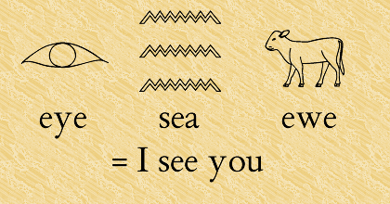
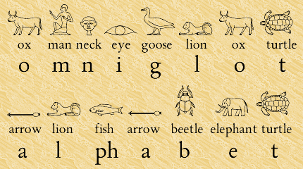
The Principles Involved in Writing
Rebus principle
A way of representing a word or part of a word with a picture.
Acrophonic principle
A way to represent sounds based on the initial sound of letter names

Slide 8
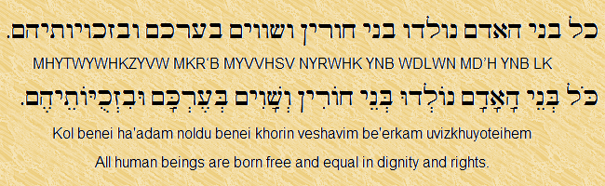
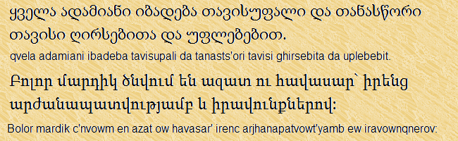
Types of writing system
Abjads / Consonant Alphabets
Consist of consonants with optional vowel indication
(Phonemic) Alphabets
Consist of consonants and vowels

Slide 9
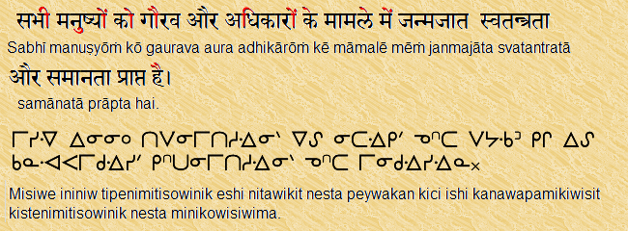
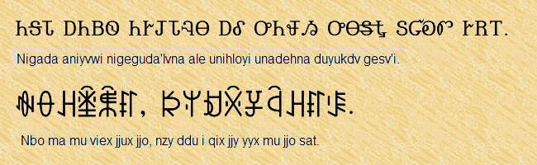
Types of writing system
Abugidas / Alphasyllabaries /
Syllabic Alphabets
Consist of consonants with modifiable inherent vowels, plus separate vowel symbols
Syllabaries
Consist of separate symbols for each syllable

Slide 10
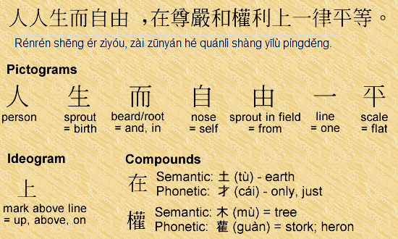
Types of writing system
Semanto-phonetic scripts
Combine semantic and phonetic elements, including:
pictograms
ideograms
phonetic symbols
semantic symbols
compound symbols

Slide 11
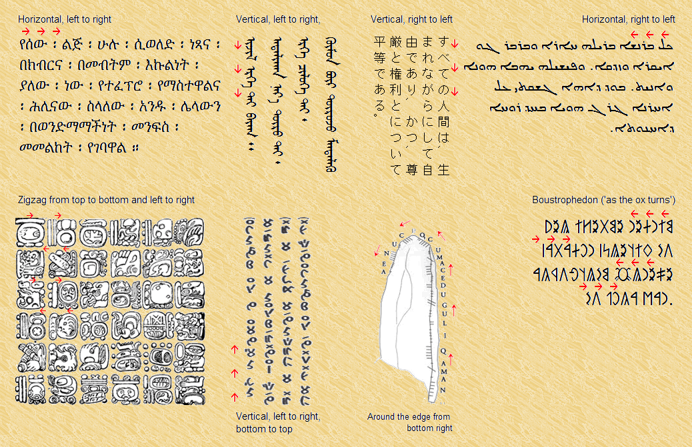
Writing direction
Many scripts started off with variable directionality and then settled to one direction.
Left to right in horizontal lines is the most popular direction (other directions are available).

Slide 12
Writing systems statistics
According to Ethnologue:
7,105 languages
3,570 have writing systems
696 are unwritten
No data for the rest
There are some 184 writing systems
71 are in regular use
33 are used to a limited extent
80 are no longer used
Types of writing system
19 abjads
56 alphabets
71 abugidas
22 syllabaries
16 semanto-phonetic scripts
Most widely-used writing systems
Latin/Roman
Cyrillic
Arabic
Devanagari

Slide 13
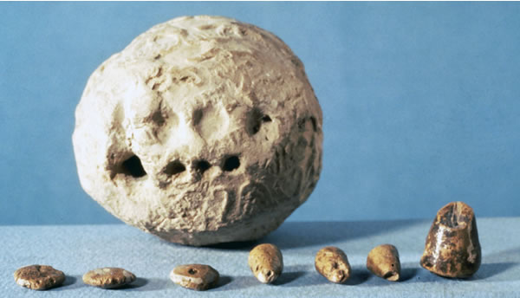
Clay tokens (c. 8,000 BC)
Used in: Mesopotamia (Israel, Syria, Turkey, Iraq and Iran)
Used from: c. 8,000-1,500 BC
Number of shapes: c. 500
Use: record keeping - Sumerian script possibly based on them.

Slide 14
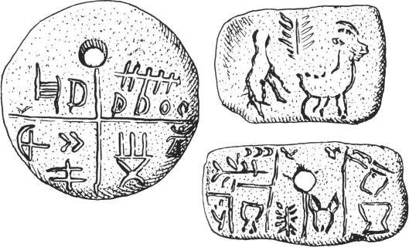
Vinča / Old European script (8,000 BC)
Used in: Romania and Serbia
Used from: c. 8,000-6,500 BC
Type of script: Proto-writing?
Direction of writing: variable
Used to write: ?
Number of glyphs: c. 100
Tărtăria tablets

Slide 15
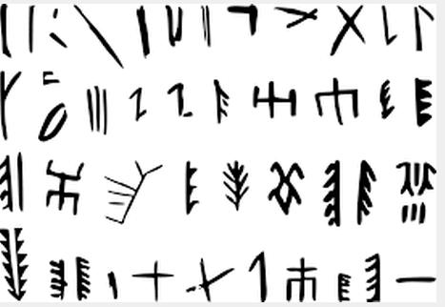
(Proto-)Writing in China (c. 6,600 BC)
Used in: Jiǎhú (賈湖), Henan province, and other parts of China
Used from: c. 6,600 BC
Type of script: Proto-writing?
Direction of writing: variable
Number of glyphs: c. 100

Slide 16
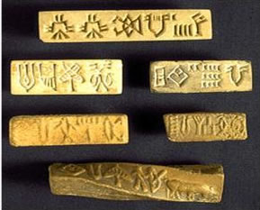
Indus script (c. 3,500 BC)
Used in: Indus valley, India
Used from: c. 3,500-1,900 BC
Type of script: undeciphered
Direction of writing: variable
Used to write: Proto-Dravidian / Sanskrit (?)

Slide 17
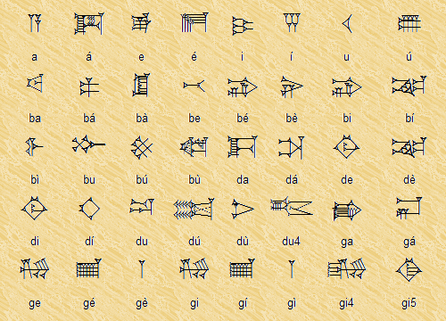
Cuneiform (c. 3,600 BC)
Used in: Mesopotamia
Used from: c. 3,600 BC - 75 AD
Type of script: semanto-phonetic / syllabic
Direction of writing: variable
Used to write: Sumerian, Akkadian, Hittite, Persian, Ugaritic, etc.
Number of glyphs: 1,000 (plus 500 variants)

Slide 18
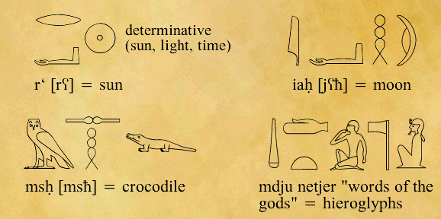
Egyptian Hieroglyphs (c. 3,400 BC)
Used in: Egypt
Used from: c. 3400 BC - 396 AD
Type of script: semanto-phonetic
Direction of writing: variable
Used to write: Egyptian
Number of glyphs: 5,000+ (700 in common use)
Reputedly invented by the god Thoth

Slide 19
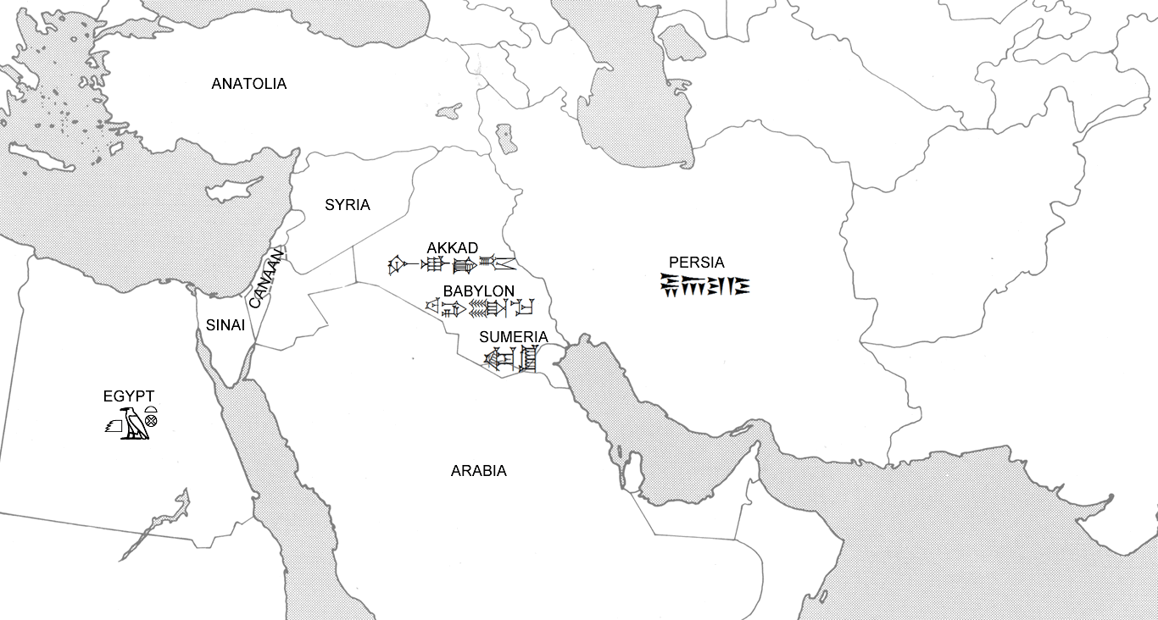
Map of ancient Mesopotamia

Slide 20
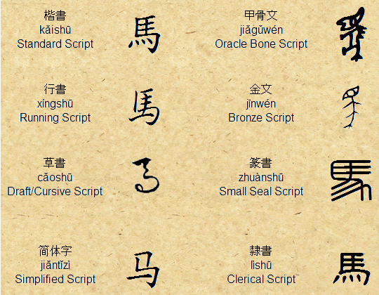
Chinese script (c. 2,100 BC)
Used in: China, Taiwan, Singapore, etc.
Used from: c. 2,100 BC - present
Type of script: semanto-phonetic
Direction of writing: variable
Used to write: Chinese, Japanese, Korean, Vietnamese, Zhuang, etc.
Number of glyphs: c. 50,000
Reputedly invented by Cāngjié (倉頡/仓颉)
in around 2,650 BC

Slide 21
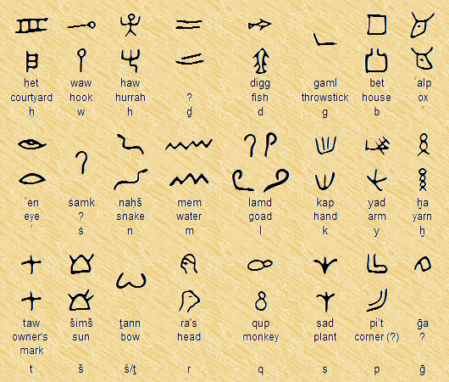
Proto-Sinaitic (1,900 BC)
Used in: Sinai and Egypt
Used from: c. 1,900-1,700 BC
Type of script: abjad
Direction of writing: variable
Used to write: Canaanite
Number of glyphs: 24 (plus variants)

Slide 22
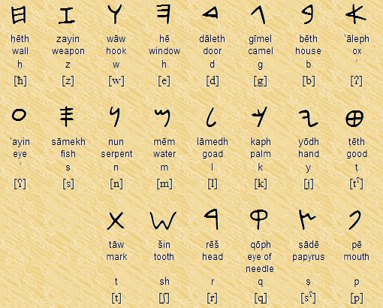
Phoenician alphabet
Used in: Phoenicia and Phoenician colonies
Used from: c. 1,000 BC - 200 AD
Type of script: abjad
Direction: boustrophedon / rtl
Used to write: Phoenician
Number of letters: 22

Slide 23
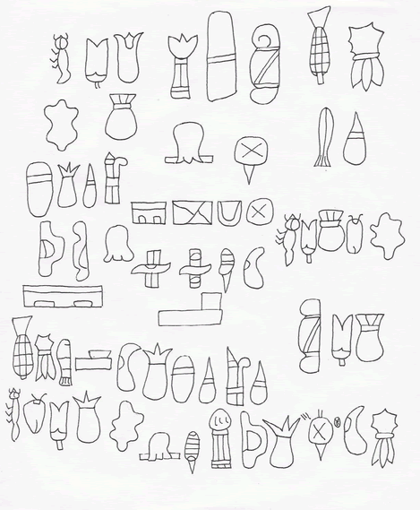
Olmec script (c. 1,000 BC)
Used in: Oaxaca, Mexico
Used from: c. 1,000 BC
Type of script: undeciphered
Direction of writing: uncertain
Used to write: uncertain
Number of glyphs: uncertain

Slide 24
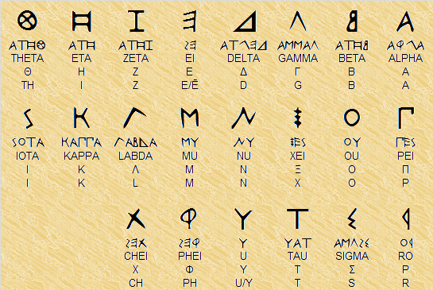
Greek - the first phonemic alphabet
Used in: Greece and Greek colonies
Used from: c. 730 BC - present
Type of script: alphabet
Direction of writing: boustrophedon / ltr
Used to write: Greek
Number of letters: 22 / 24

Slide 25
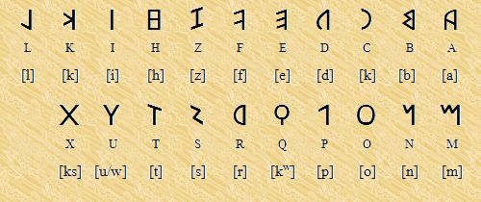
Latin alphabet
First used in: Italy
Used from: c. 700 BC - present
Type of script: alphabet
Direction: variable / ltr
Used to write: Latin and many other languages
Number of letters: 26+
Based on: Etruscan alphabet

Slide 26
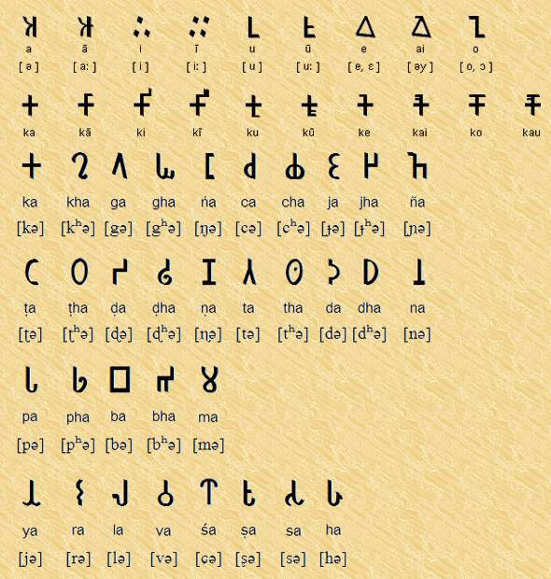
Brahmi script
Used in: India
Used from: c. 500 BC - 4th century AD
Type of script: abugida
Direction of writing: variable / ltr
Used to write: Sanskrit, Prakit, etc
Number of glyphs: 43

Slide 27
Sources
Books
Coulmas, Florian, The Blackwell Encyclopedia of Writing Systems (Oxford, Blackwell, 1999)
Coulmas, Florian, The Writing Systems of the World (Oxford, Blackwell, 1991)
Daniels, Peter T. & Bright, William, The world's writing systems (Oxford, Oxford University Press, 1996)
Robinson, Andrew, The Story of Writing (London, Thames and Hudson, 1995)
Websites
Omniglot - http://www.omniglot.com
Wikipedia - http://en.wikipedia.org
Ethnologue - http://www.ethnologue.com
Chinese Etymology - http://www.chineseetymology.org

Slide 28
ᑲᓇᓇᐢᑯᒥᑎᐣ
ど
う
も
あ
り
が
と
う
ご
ざ
い
ま
す
Thank you
謝
謝
ඉස්තුති
Спасибо
ᏩᏙ
ຂອບໃຈ
ഉപകാരം
ޝުކުރިއްޔާ
நன்றி
ধন্যবাদ
շնորհակալություն
ﺷﻜﺮﺍﹰ
გმადლობთ
አመሰግናለሁ
אַ שיינען דאַנק
ཐུགས་རྗེ་ཆེ་།

